Slide 1
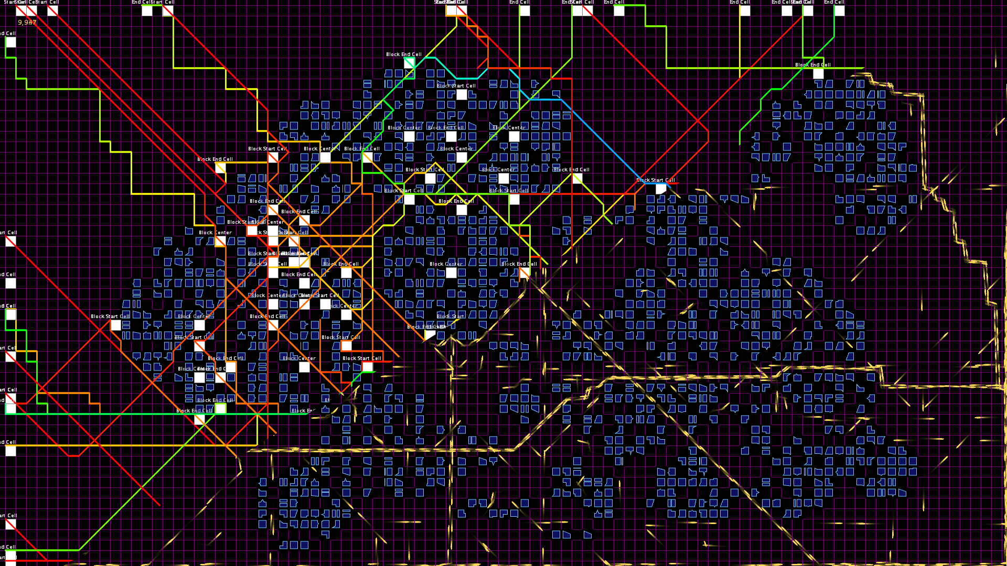
Generative City
Raoul Zander, Creative Coding, 6. Semester, HDPK

Slide 2
Konzept
Nutzer können eine Stadt „malen“
Generative Algorithmen erzeugen das Stadtleben

Slide 3
Eingesetzte Bibliotheken
Partikelsystem „Punktiert“ von Daniel Koehler
Pfadfindung „Path_Finder“ von Peter Lager
Vereinfachtes Path-Following nach Craig Reynolds

Slide 4
Erzeugung eines Gebäudes
Code Beispiel

Slide 5
abstract class BuildingShape {
abstract PShape createShape(float width, float height);
int getProbability() {
return 1;
}
boolean canBeRotated() {
return true;
}
public PShape newShape(float width, float height) {
PShape shape = createShape(width, height);
if (canBeRotated()) {
int random = Numbers.random(0, 3);
switch (random) {
case 1:
shape.translate(width, 0);
break;
case 2:
shape.translate(width, height);
break;
case 3:
shape.translate(0, height);
break;
default:
break;
}
shape.rotate(random * HALF_PI);
}
return shape;
}
}

Slide 6
class BuildingShapeFactory extends ArrayList<BuildingShape> {
private static final BuildingShapeFactory INSTANCE = new BuildingShapeFactory();
private int totalSum;
private BuildingShapeFactory() {
// Rechteck mit einbuchteter Ecke
add(new BuildingShape() {
@Override
PShape createShape(float width, float height) {
PShape shape = $.createShape();
shape.beginShape();
shape.vertex(0, 0);
shape.vertex(width, 0);
shape.vertex(width, height);
float notchWidth = width * $.random(0.1f, 0.7f);
shape.vertex(notchWidth, height);
float notchHeight = height * $.random(0.3f, 0.9f);
shape.vertex(notchWidth, notchHeight);
shape.vertex(0, notchHeight);
shape.endShape(CLOSE);
return shape;
}
@Override
int getProbability() {
return 2;
}
});
for (BuildingShape shape : this) {
totalSum += shape.getProbability();
}
}

Slide 7
public static BuildingShape getRandomBuildingShape() {
return INSTANCE.getRandomBuildingShapeInternal();
}
private BuildingShape getRandomBuildingShapeInternal() {
int index = Numbers.random(totalSum) + 1;
int sum = 0;
int i = 0;
while (sum < index) {
BuildingShape item = get(i++);
sum += item.getProbability();
}
return get(i - 1);
}

Slide 8
class Building {
final static color BACKGROUND = #5E232BFF;
final static color STROKE = #FF78CCFF;
BuildingShape buildingShape;
PShape shape;
float x, y;
public Building(float x, float y, float width, float height, float padding) {
this.buildingShape = BuildingShapeFactory.getRandomBuildingShape();
$.fill(BACKGROUND);
$.stroke(STROKE);
$.strokeWeight(1);
shape = buildingShape.newShape(width - (2 * padding), height - (2 * padding));
this.x = x + padding;
this.y = y + padding;
}
void draw() {
$.shape(shape, x, y);
}
}

Slide 9
Ausblick
Tronmäßig leuchtende Farben
Verschiedene Stadtstile: Natürlich, Futuristisch, Geplant
Zeitregler, um sich seine Stadtentwicklung anzuschauen
Alternative Perspektiven und Darstellungen
Performance-Optimierung für 60 fps auch bei komplexen Städten

